Slide 1
The Water Quality eXchange Introduction and Regional Approaches for Adoption
Gulf of Mexico Alliance, Data & Monitoring Team Mid-Year Meeting
1/25/2023
Adam Griggs, Office of Water, Water Data Integration Branch

Slide 2
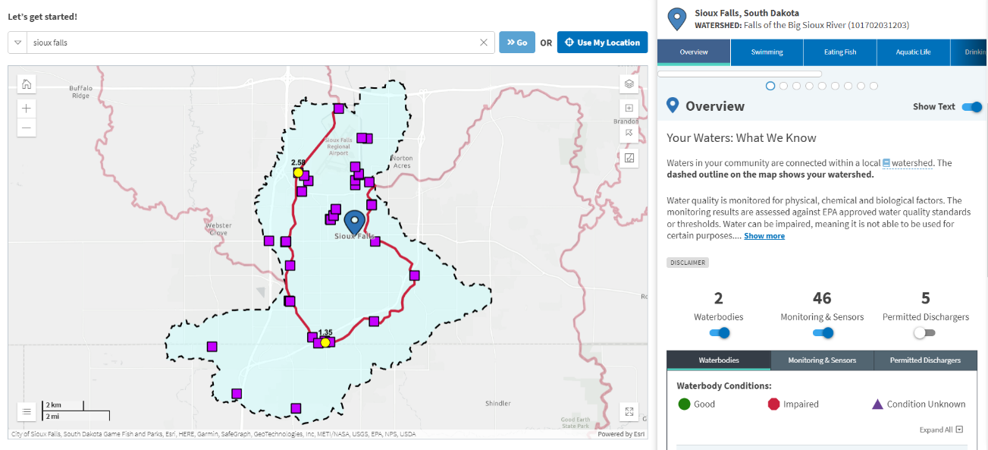
Goals for Today
Get an Update on WQX and connected National water data systems
Learn how these tools help turn water quality data into public information
Better understand how data can be shared to or through WQX/WQP
Share examples of data management strategies/tech being deployed across the country
Notes:
Hi everyone,
I’m Adam Griggs from EPA’s Water Data Integration Branch, in the Office of Water, and I’m excited to be presenting today as part of the EPA’s Watershed Academy. The title of our webcast is Turning Water Data into Public Information, and we’ll be hearing from several speakers and programs who are doing just that. First, I’d like to set the groundwork for our presentations, and introduce some concepts that should help frame the information and examples that will follow.
We’ll talk briefly about the challenges of turning data into public information, identify best practices for organizing monitoring data and integrating local data with national data systems, and share examples of data management strategies being deployed across the country.
The screenshot below is from How’s My Waterway, and if you’ve attended these webcast before you are probably already familiar, but if you’re not I encourage you to visit (just not now), or watch a recording of my teammates presenting on HMW here before. HMW is a public information portal about our waters where you can view information about your local waters through a variety of topics. Each “topic” tends to represent a data stream that the system is reading in to show you. HMW does not store or manage any data itself. It simply reads data in from a variety of open public systems like the EPA’s Water Quality Portal, ATTAINS data system, or the ECHO database, etc.
It is but one example of how you can collect water data and try to communicate it as public information and serves as an example of the ways that you can integrate data from web services. The How’s My Waterway team released several enhancements to the monitoring tab on 9/01/22 including the ability to view monitoring data by watershed anywhere from the late 1800s to 2022 by selecting a date range. Separate monitoring location pages were also added which include ways to dig deeper into the data, view it on a chart by characteristic group and filter the data before downloading. But that data takes quite the journey to get here.

Slide 3
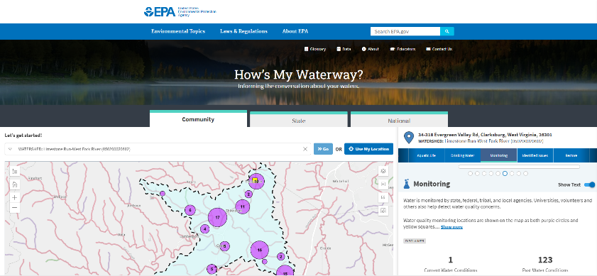
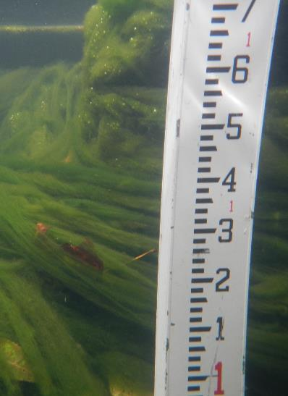
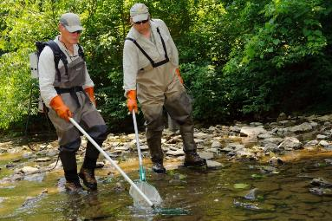
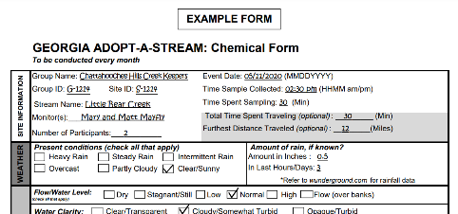
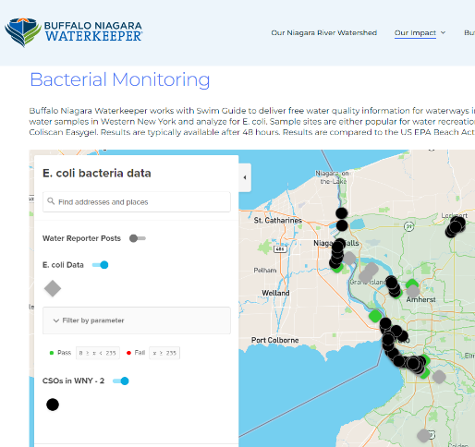
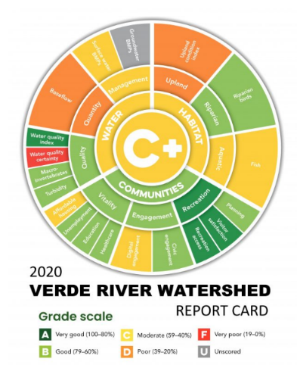
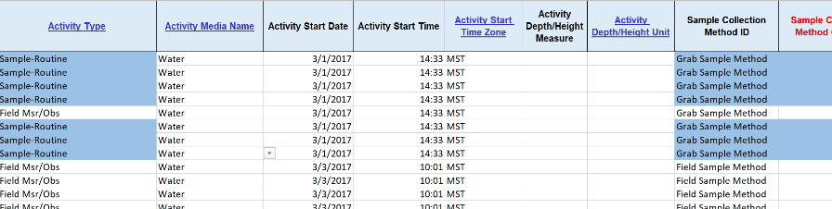
Data
Public Information
Notes:
The data we collect from our watersheds is inherently messy. Not in the sense that we get messy collecting it, but that in the pursuit of gathering information about our watersheds, we inevitably end up combining data from visual observations, field measurements, lab samples, biological samples we score into metrics, and geospatial data, just to name a few. Along the way, we have to manage, and process that data, assess its quality, and combine datasets together so that we might ask and answer questions about the conditions of our waters, or use that data to guide our work to protect and restore them. Providing public information about our waters is essential for both the safety of public water users but also the waters alike in that informing the public helps raise support for restoration.
Public information does not usually look like data. In order to be communicated effectively, it often helps to provide summaries and conclusions over raw data, or to develop and deploy scoring systems that easily indicate condition by color or grade. There are many steps taken in order to move messy raw data to polished communication products. One term for this process is the Lifecycle of Data.

Slide 4

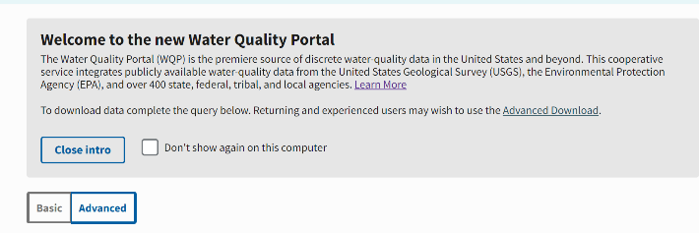
EPA Connected Water Data Systems
Data Aggregator
How’s My Waterway?
Data Warehouse
Water Quality Portal
Data Standard
Water Quality eXchange
Notes:
At EPA, and nationally here in the US. The standard for describing and sharing water data from surface waters is the Water Quality Exchange or WQX. WQX forms a foundation for connected and integrated public water data. In our systems, data shared through WQX are warehoused and served in the Water Quality Portal. In addition to serving users with downloadable datasets, the WQP also supplies data as web services which allow other web-based applications like How’s My Waterway to query, retrieve, and display data through the web. In our connected systems, WQX provides the Standard, WQP serves as the data warehouse, and How’s My Waterway presents that data as publicly accessible information. In the examples we look at today, all integrate with these systems at some point.

Slide 5
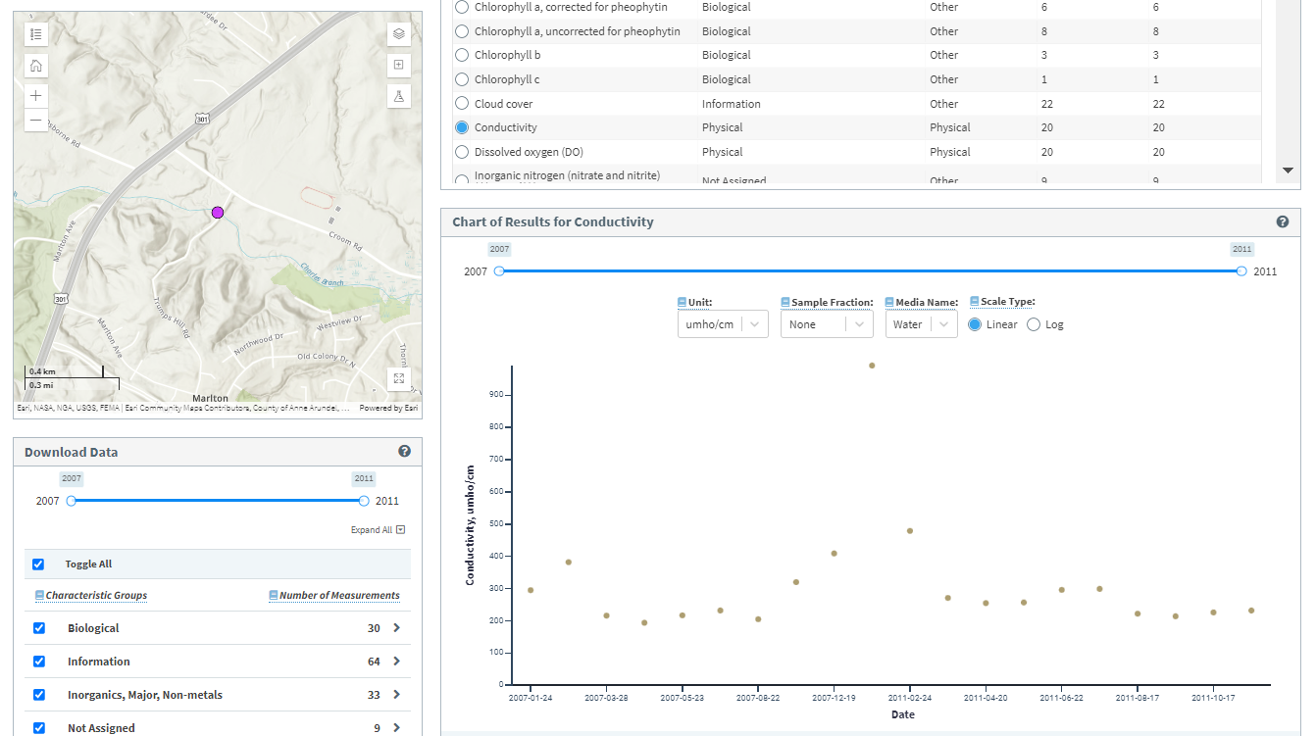
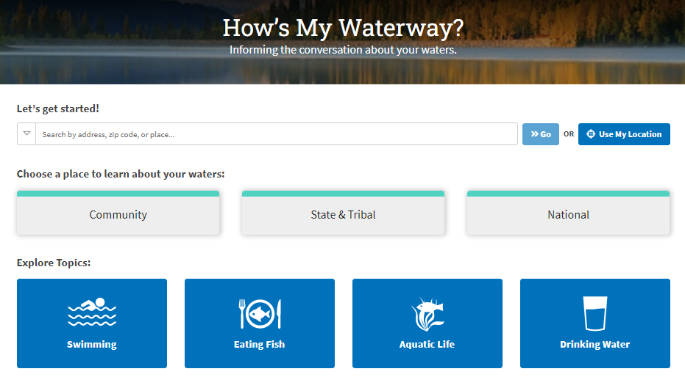
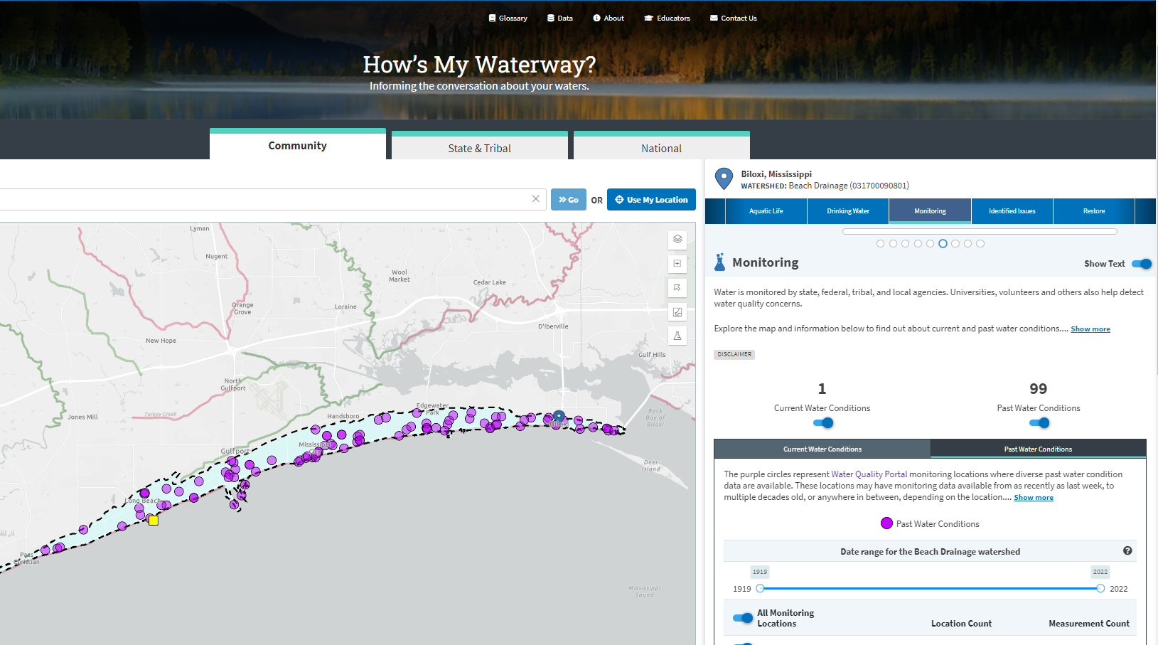
How’s My Waterway
Now includes a full interface for Water Quality Portal result level data
Filter, chart, explore, and download data directly from HMW.

Slide 6
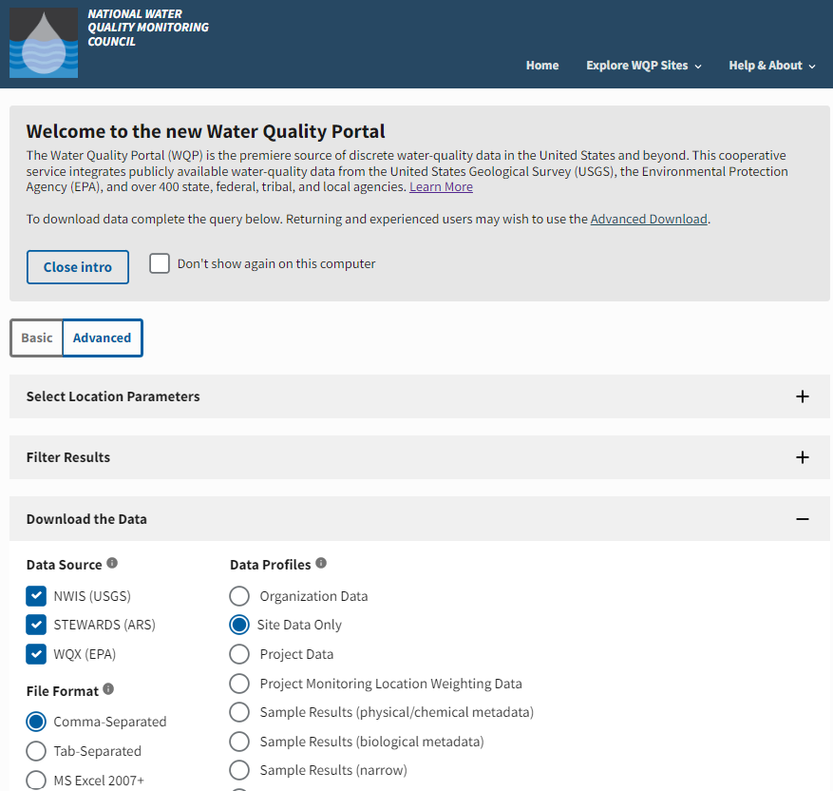
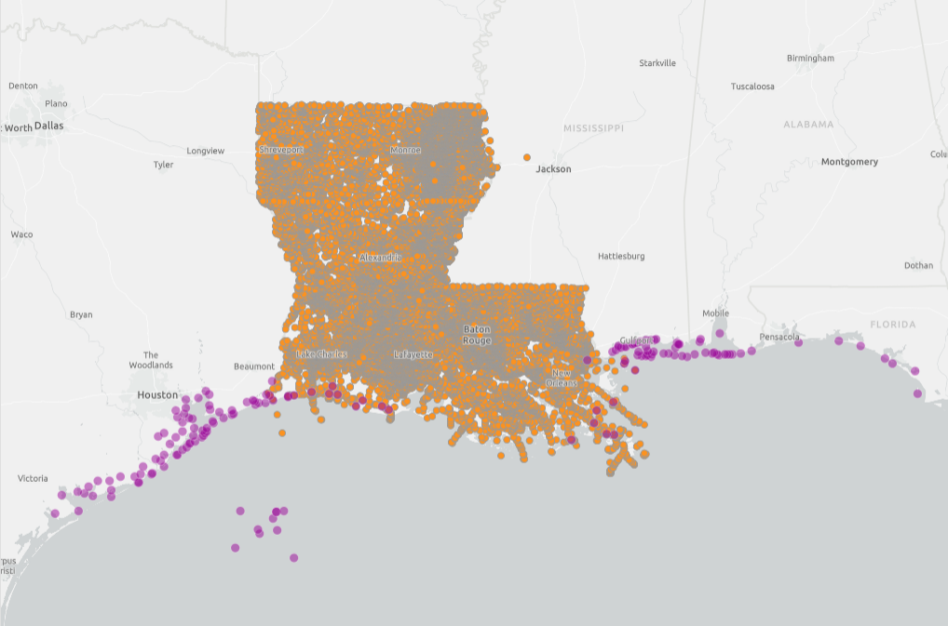
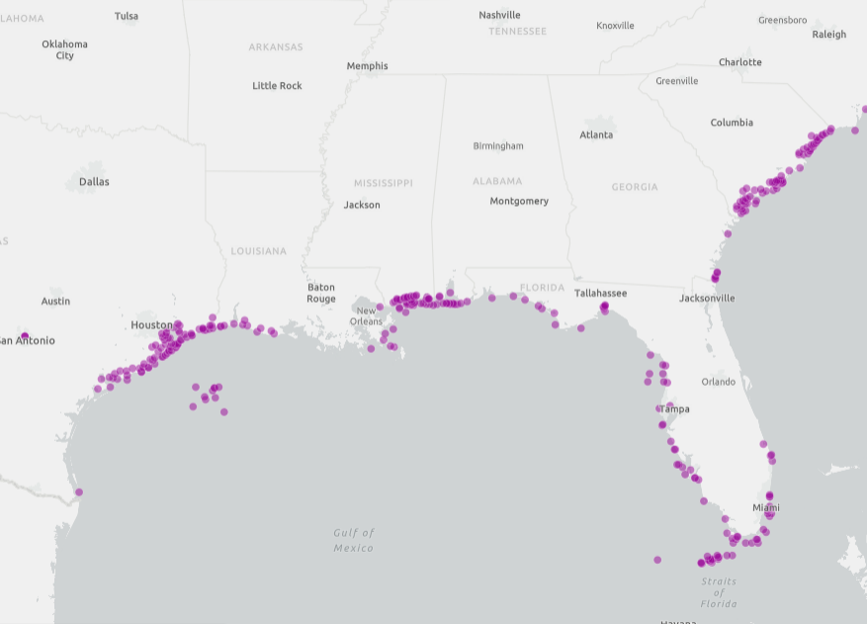



Water Quality Portal
Operated under An Interagency Cooperative agreement (USGS & EPA)
Serves data from USGS, EPA, USDA, NPS in a standard WQX format
# WQP: Data from >1,600 organizations
# WQP: >410m records from >1m sites
Serves data OF All Water Types
Includes a Graphical User Interface (GUI) & Web Services
One of Our Integrated Systems (IOW HUB)
DATA ServiceS can directly power analytics like those in HMW
Growing Number of internal/external Tools built on top of this Primary data source
Data Warehouse
WQP
WQX
HMW
Data Standards
Public Information

Slide 7
What Is WQX?
WQX is a ‘standardized’ based approach for sharing water quality monitoring data of various types
WQX defines a common data model for communicating water quality data (sample data)
Designed to be automated
The structure of partner data systems don’t matter, so long as they can map data to WQX standards
Many ways to prepare and submit data to WQX: including direct submissions, WQXWeb, and 3rd party apps

Slide 8
What does WQX do?
WQX is a results-based database designed to store environmental sample data
Sample media: Water, air, soil, sediment, tissue, biological, habitat!
Data types: Observations, photos, measures, metric values, indexes
~300 fields available to help you describe your data
~75 controlled fields with certain allowable values (harmonization)
Takes data of all these types and formats and harmonizes them to a standard structure and nomenclature

Slide 9
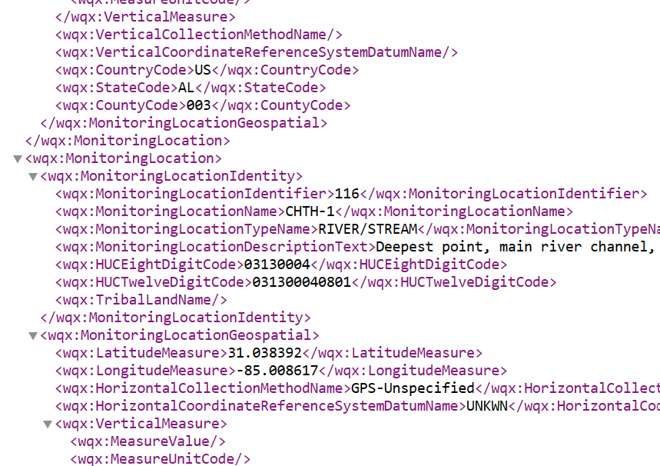








Ways to share your data to WQX
WQXWeb
T
Little help please
Tools to help you map, reformat, and document your dataset
A WQX formatted XML file
+
→
Dataset
Import
Configuration
WQX-XML
WQX
2x/week
WQP
API
Central Data Exchange
I got this
Only registered users
Data must pass validation:
Complete
Unique
Adheres to allowable values

Slide 10
How can partnerships, technology, and the internet help us solve these challenges?
Doesn’t require a database, simply organize and share the data to WQX, and let WQP web services power your data displays
Regional Data Hub
Data Management
(WQX)
Data Sharing
(WQP)
Data Use (HMW)
Online
Off-line
Study Design
Data Collection
Data Management
Data Analysis
Data Use / Sharing
Notes:
If we take these three national data systems, we can line them up over the Lifecycle of Water Data to see where they can assist with tackling these steps. Many programs across the country these days point part of their data flow to or through these same systems.
In many parts of the country there may be a regional monitoring program that collects and assembles the data from data collectors across their region. Often, these system help to achieve certain data sharing or public communication goals for those who have collected that data. Increasingly often, we are also seeing these Hubs connect their data to the National Water Data Systems by uploading their assembled data to WQX on behalf of the numerous data collectors, and/or retrieving data from the WQP to integrate in their data viewer.
We will see examples of each in today’s presentations.

Slide 11
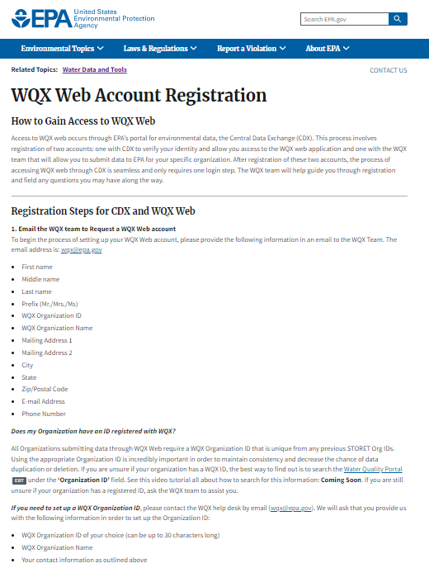
Getting Started
How to Sign up for a CDX/WQXWeb account
1. Email the WQX team to Request a WQX Web account
The email address is: wqx@epa.gov
First name
Middle name
Last name
Prefix (Mr./Mrs./Ms)
WQX Organization ID
WQX Organization Name
Mailing Address 1
Mailing Address 2
City
State
Zip/Postal Code
E-mail Address
Phone Number
How to Register Page: https://www.epa.gov/waterdata/wqx-web-account-registration

Slide 12
How Data is Organized in WQX “The Schema”
Think of the data as being stored in levels
All Organizational Info
All Project Info
All Location Info
Org ID | Org Name
001 | Minnesota Depart
002 | Kentucky Departm
003 | University of Was
Prjct ID | Project Name
001 | Cyano Monitoring
002 | Probabalistic mon
003 | Trends Program
Loc ID | Location Name
001 | Deep Blue Lake
002 | Muddy Run
003 | Fishing Creek
All Result-level Info and metadata
Unique Activities
Activity ID | Characteristic | Value | Unit
003 | pH | 7.6 | SU
003 | Temperature | 19.1 | Deg C
003 | Conductivity | 236 | µS/cm
Activity ID | Sample Date
001 | 5/3/2012
002 | 4/17/2016
003 | 4/23/2020

Slide 13
What Data are Required by WQX?
All Organizational Info
All Project Info
Org ID | Org Name
001 | Minnesota Depart
002 | Kentucky Departm
003 | University of Was
Prjct ID | Project Name
001 | Cyano Monitoring
002 | Probabalistic mon
003 | Trends Program
Organization Name
Contact Information
Organization Type
Address
Project Name
Sampling Design Type
QAPP Indicator
Attached Files
All Location Info
Mandatory
Optional
Loc ID | Location Name
001 | Deep Blue Lake
002 | Muddy Run
003 | Fishing Creek
Location Name
Location Type
Geospatial
Well information*
Description
HUC, municipal
Alternate IDs
Tribal designation

Slide 14
What Data are Required by WQX?
Unique Activities
Mandatory
Activity ID | Sample Date
001 | 5/3/2012
002 | 4/17/2016
003 | 4/23/2020
Media
Sample Type
Sample Method
Sample Equipment
All Result-level Info and metadata
Activity ID | Characteristic | Value | Unit
003 | pH | 7.6 | SU
003 | Temperature | 19.1 | Deg C
003 | Conductivity | 236 | µS/cm
Mandatory
Conditional
Optional
Characteristic
Units
Analytical Method
Value
Value Type
Sample Fraction
Speciation
Detection Condition
Biological*
Qualifiers
Comments

Slide 15
Resource Check-in
Topic Area | Resource Links
WQX Nuts and Bolts | Upload Resources Page Glossary of Terms Validation Rules Data Exchange Template (List of Fields) Domain Service (Allowable Values)

Slide 16
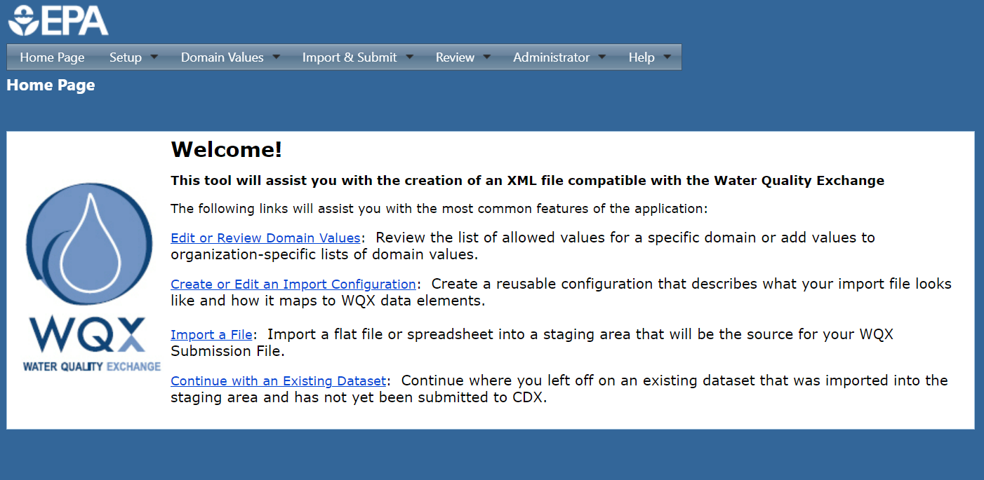
What is WQXWeb?
WQXWeb is the web client / user interface that allows users to upload, identify, manipulate, and eventually import their datasets

Slide 17


Templates and Import Configurations
Templates
Import Configurations
Standardized Data Format
Reads and Configures Data to XML

Slide 18
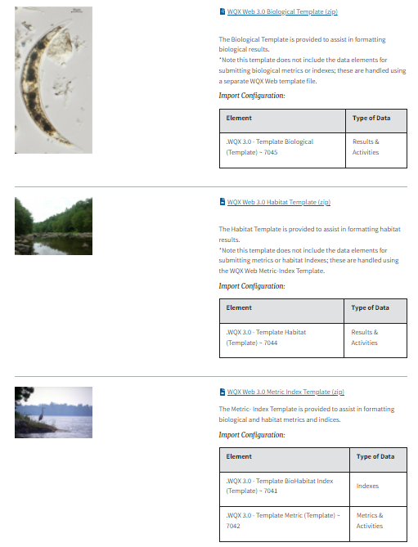
WQX Web Templates
https://www.epa.gov/waterdata/water-quality-exchange-web-template-files
Using WQX – Templates | Water Quality Exchange Web Template User Guide | US EPA Link to Web Templates Web Templates Overview Video

Slide 19
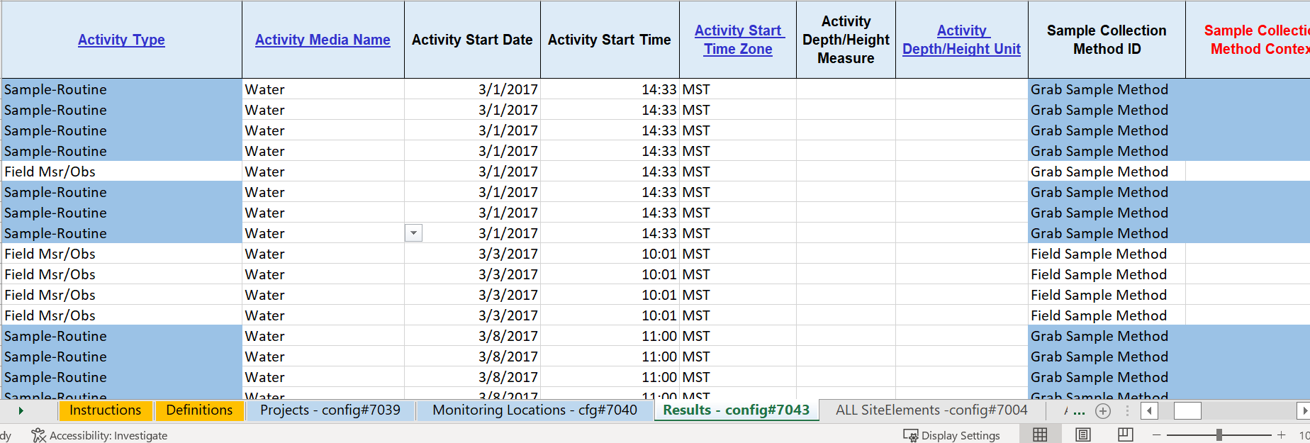
WQX Web Templates

Slide 20
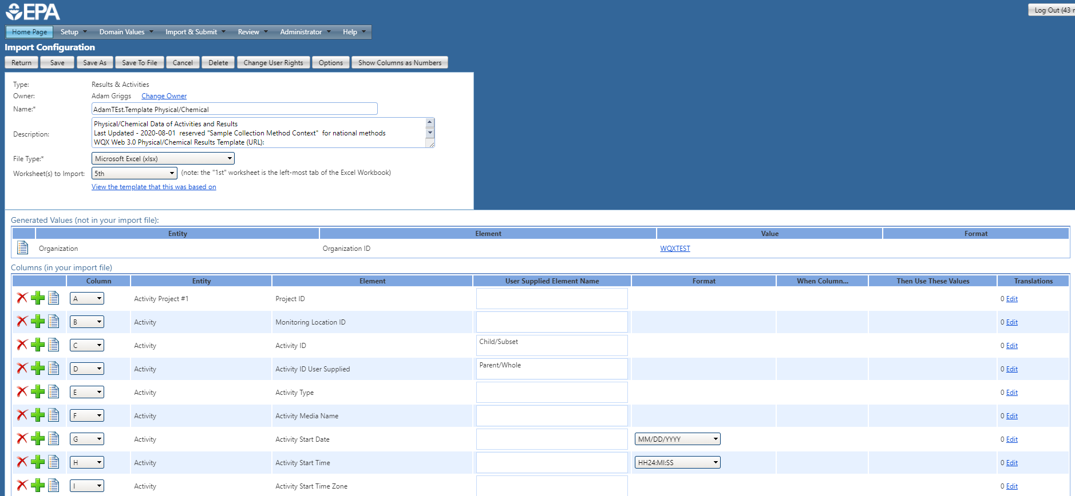
WQX Import Configurations

Slide 21
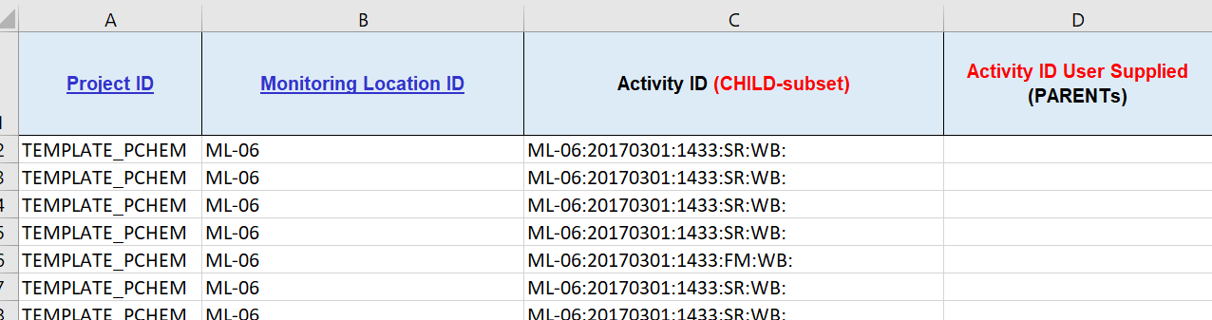
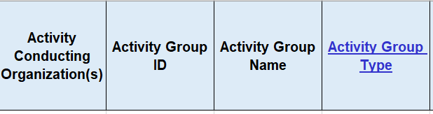
Thinking about Data Ownership
Registration and Organization
In the Dataset
WQX Users Can be given access to upload to any organization
A region/system can be set up so that either all regional data is published under one Org or individual participating Orgs

Slide 22
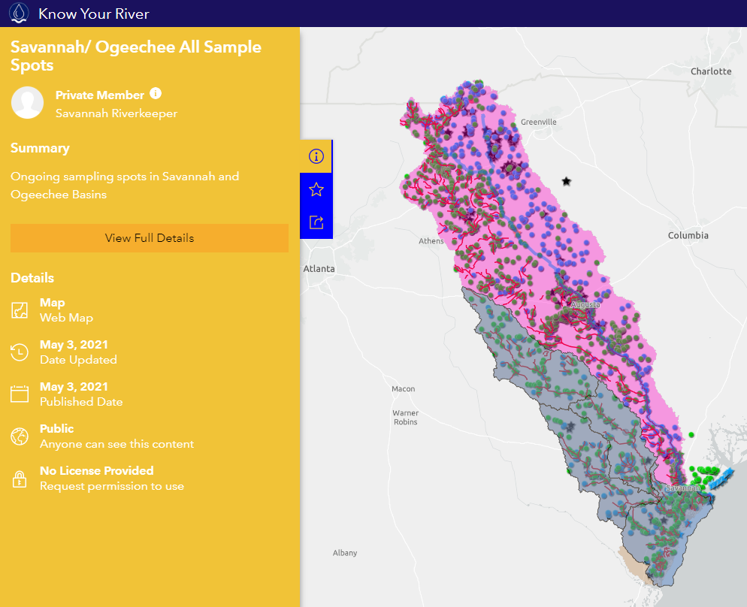
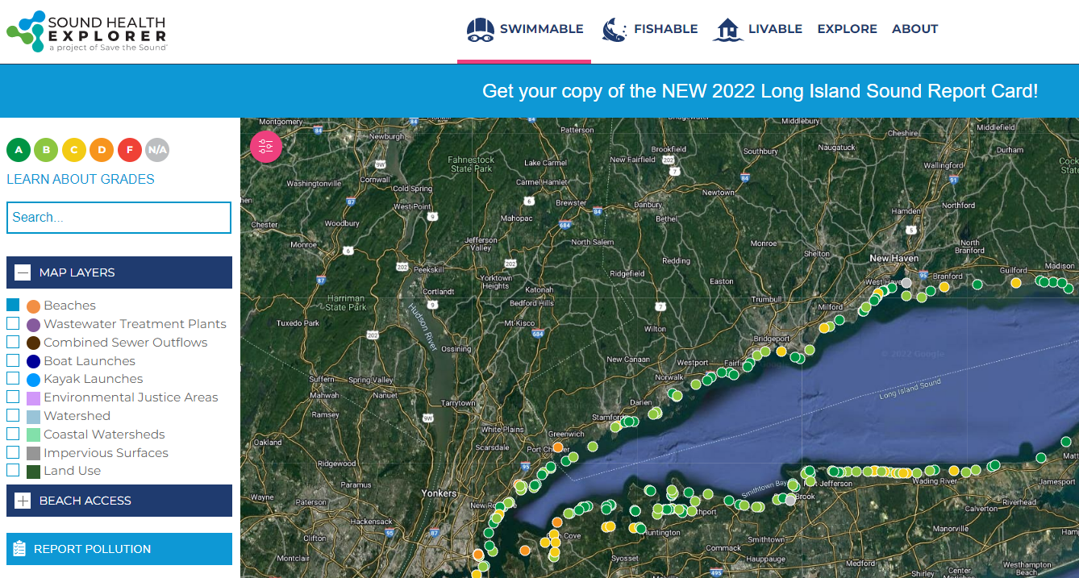
Examples of Projects Using WQX/WQP Services

